Slide 1
HW2 - Nonlinear Equations: Burgers and Shallow Water
02/19/2024 - Connor Pigg
1

Slide 2
Table of Contents
Introduction
Burgers Introduction and Algorithms
Burgers Animations
Burgers Traces
Shallow Water Introduction and Algorithms
Shallow Water Animations
Shallow Water Traces
Python Code and Numerical Settings
2

Slide 3
Burgers Introduction and Algorithms
3

Slide 4
Nonlinear Equations
Present challenges especially for method of characteristics.
Practically can be solved using Riemann Solvers (Gudonov), Conservative Numerical Schemes, or Quasilinear schemes.
4

Slide 5
Scheme Comparisons
Riemann solvers can be developed to satisfy physically realistic conditions (satisfy entropy) but are more complicated.
Conservative Numerical Schemes can solve the problem but depending on method might only solve weak solution and be unphysical.
Quasilinear schemes can be less accurate as they approximate the solution and can be nonconservative in exchange for being simple to implement.
5

Slide 6
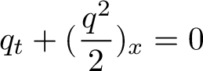
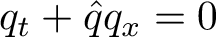
Burger's Equation
The conservative form and quasi-linear form
6

Slide 7
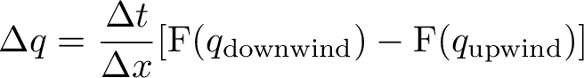
Update for Conservative
Upwinding fluxes calculated at cell centers based on characteristic velocity current cell q
7

Slide 8
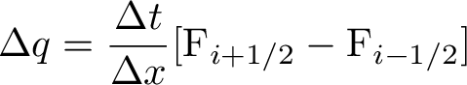
Update for Gudonov
Riemann Problem at every interface to find interface fluxes using conditional cases of Shock or Rarefaction
8

Slide 9
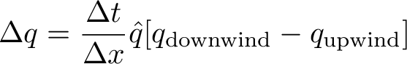
Update for Quasi-linear
Choose qhat based on qcell (naive) or Roe averaged upwinded using characteristic speed q cell
9

Slide 10
Burgers Animations
10

Slide 11
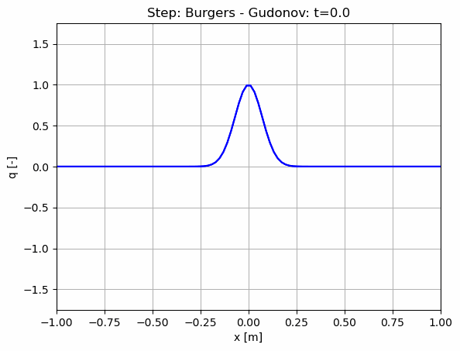
11

Slide 12
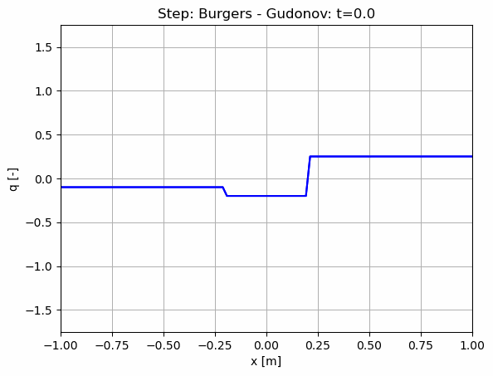
12

Slide 13
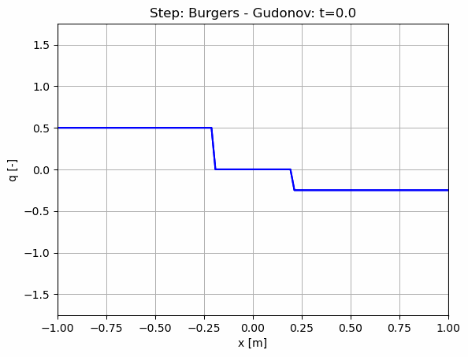
13

Slide 14
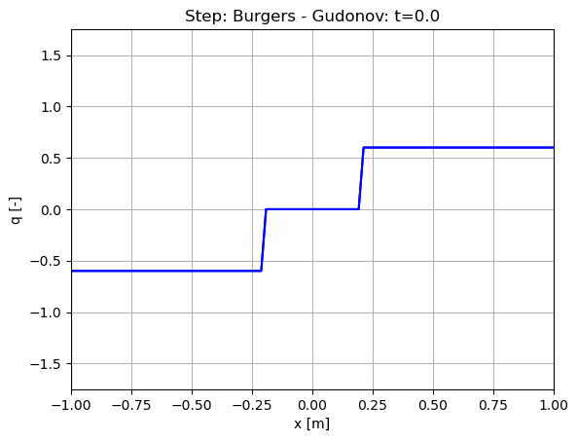
14

Slide 15
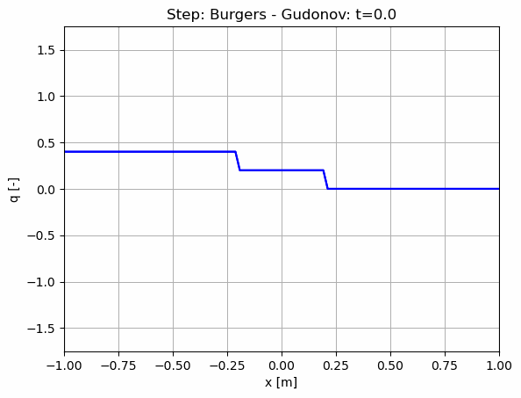
15

Slide 16
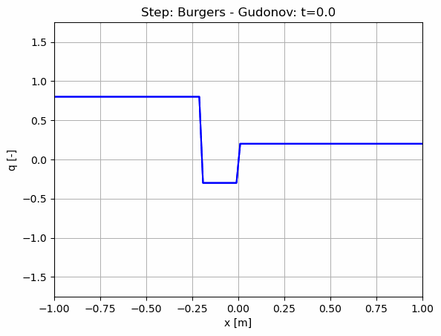
16

Slide 17
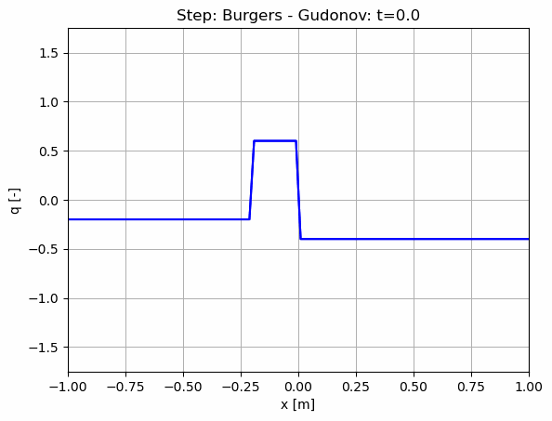
17

Slide 18
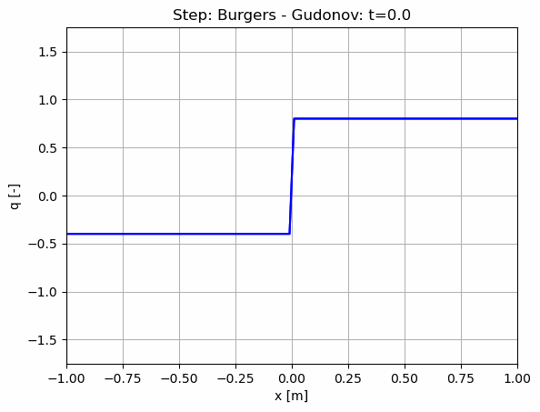
18

Slide 19
Burgers Traces
19

Slide 20
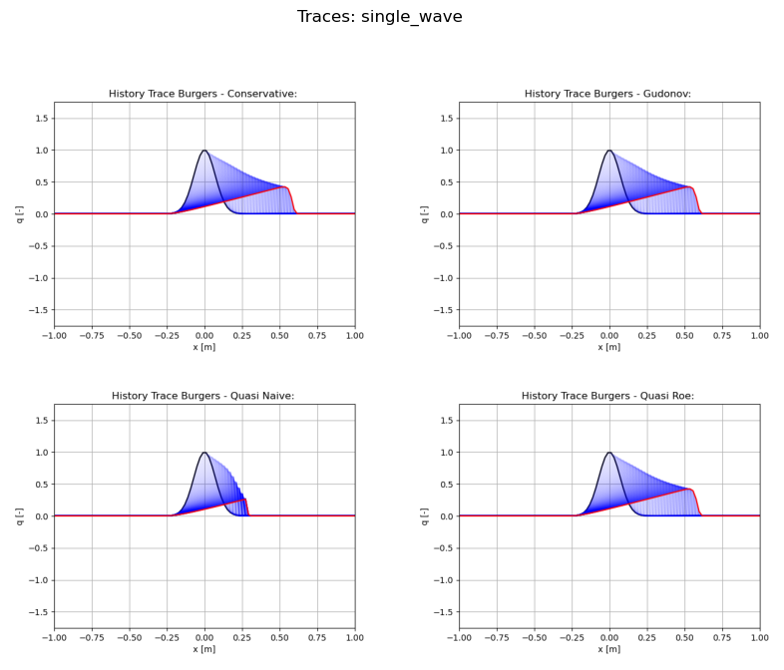
20

Slide 21
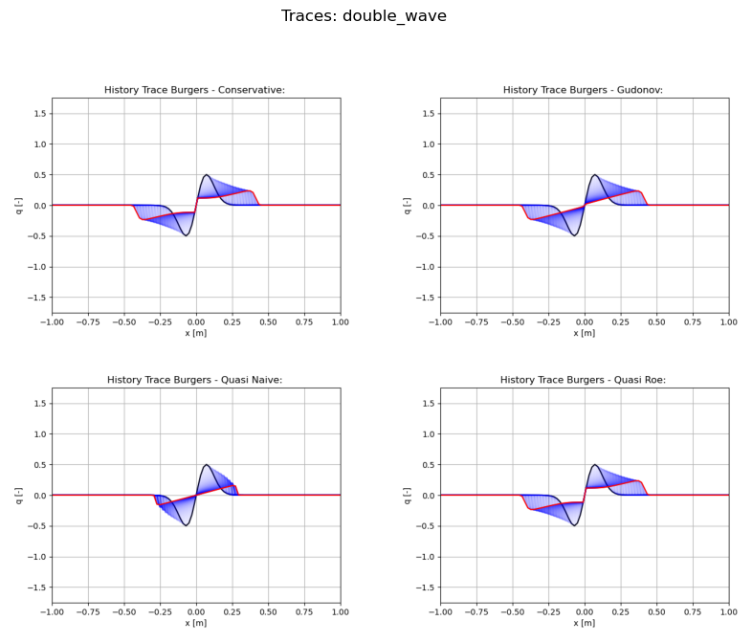
21

Slide 22
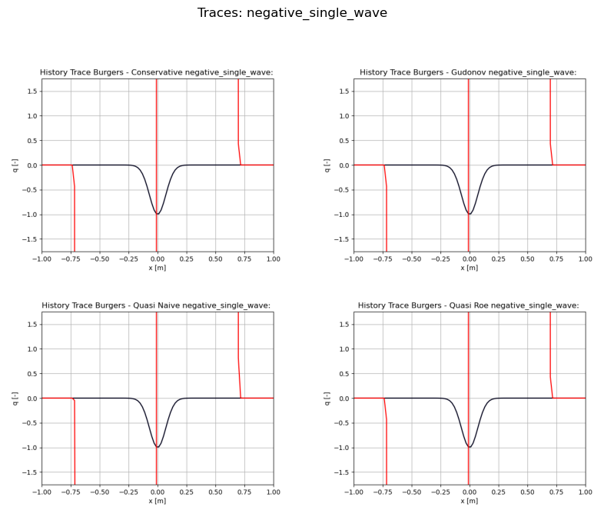
22

Slide 23
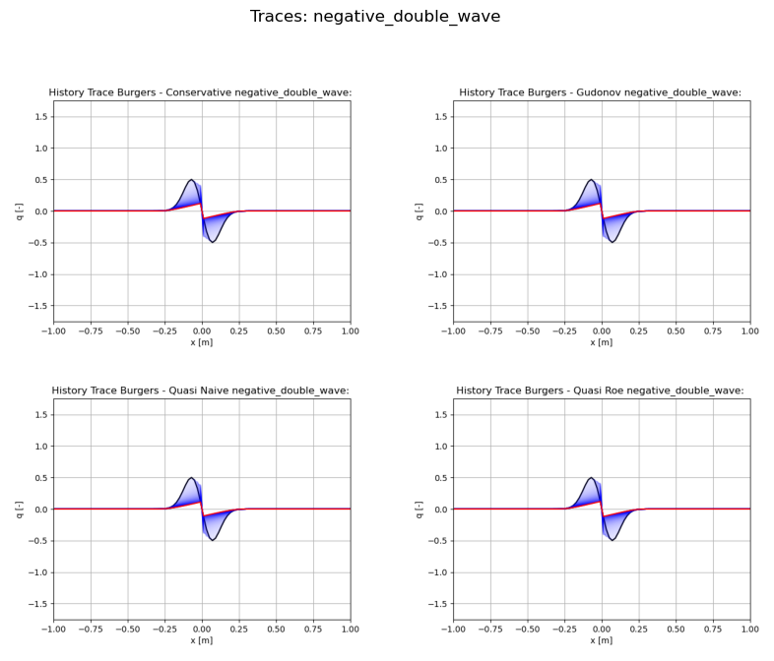
23

Slide 24
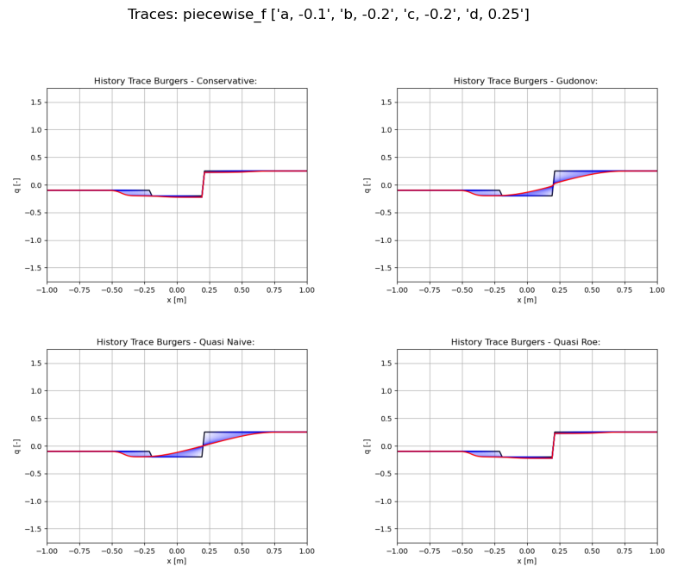
24

Slide 25
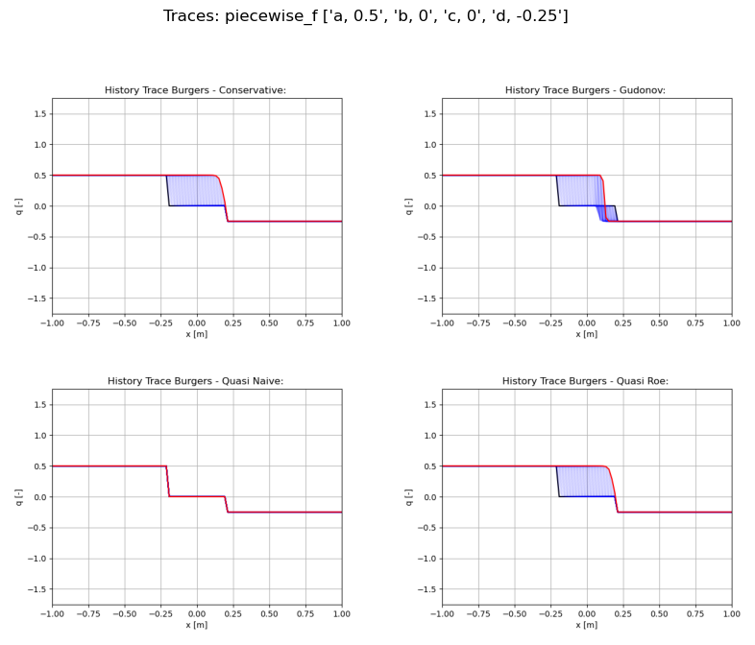
25

Slide 26
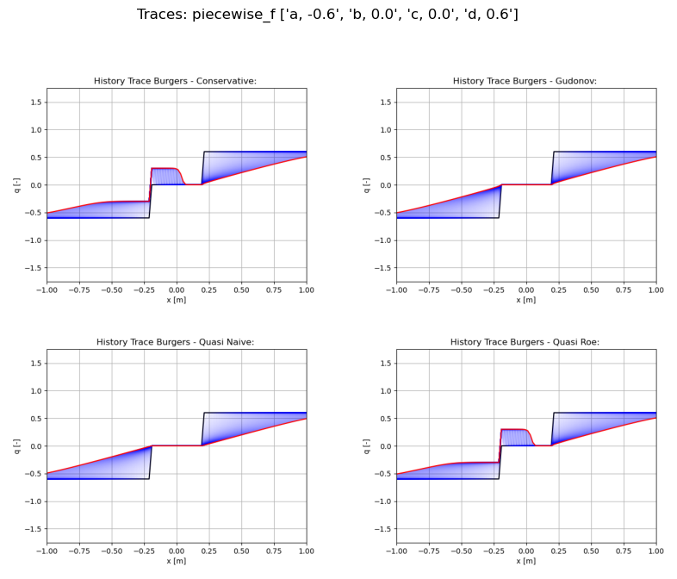
26

Slide 27
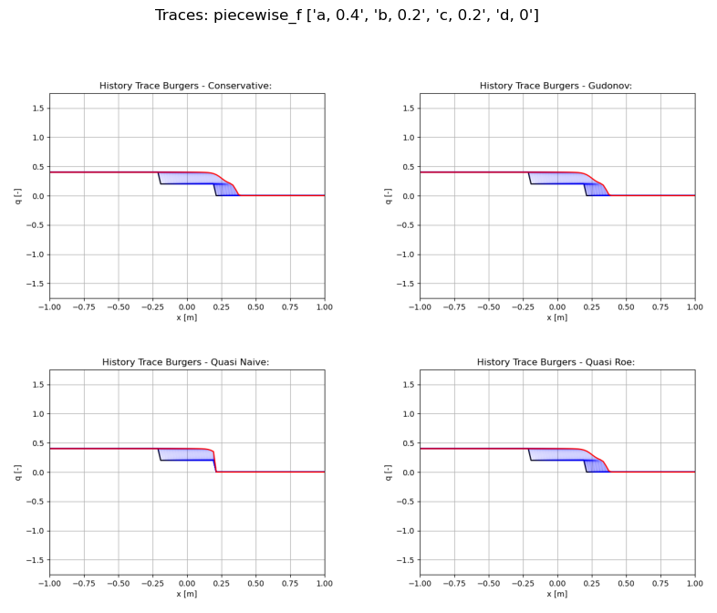
27

Slide 28
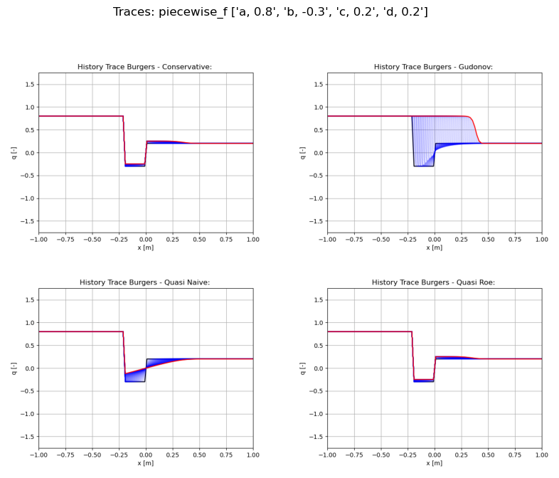
28

Slide 29
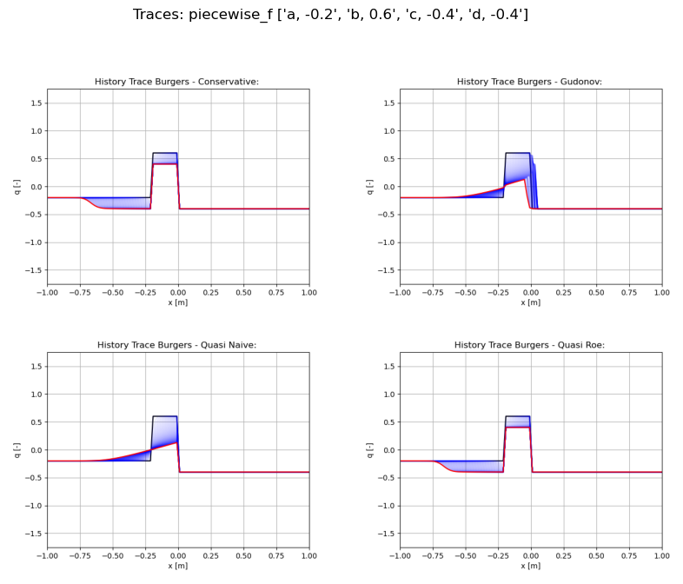
29

Slide 30
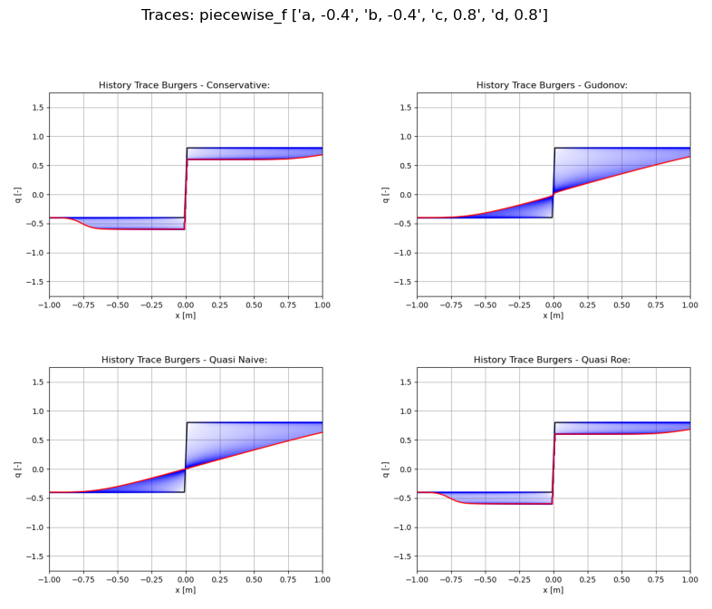
30

Slide 31
Shallow Water Introduction and Algorithms
31

Slide 32
Shallow Water Equation
The shallow water equation can be used to determine waves and ripples on a shallow body of water.
In the case of discontinuities it may represent a Dam Break problem.
Note that negative height doesn't make physical sense thus Dryout must be specifically handled.
32

Slide 33
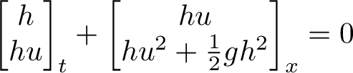
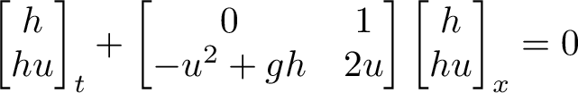
Shallow Water Equation
The conservative form and quasi-linear form
33

Slide 34
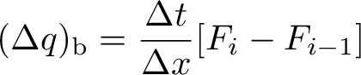
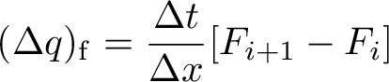
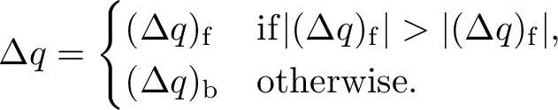
Upwinding Based on Flux Magnitude
Upwinded direction based on direction of maximum flux
34

Slide 35
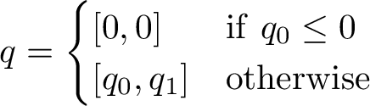
Handling Dryout
negative h unphysical and h=0 implies u=0 thus at every time step apply the following condition.
35

Slide 36
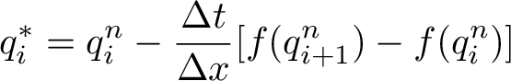
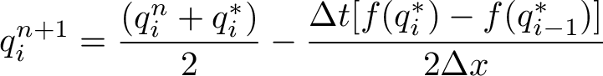
MacCormack Method
A predictor-corrector which combines forward and backward differencing
36

Slide 37
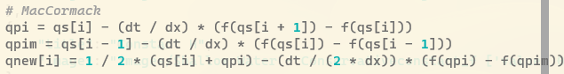
37

Slide 38
Stepping using Primitive Variables
Changes to solve step:
Convert to primitive
Time step update using primitive jacobian A
Convert back to conservative
38

Slide 39
Shallow Water Animations
39

Slide 40
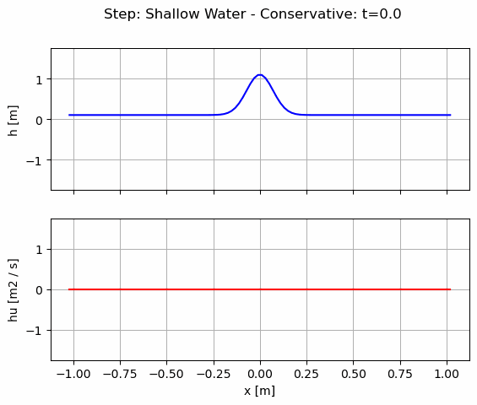
40

Slide 41
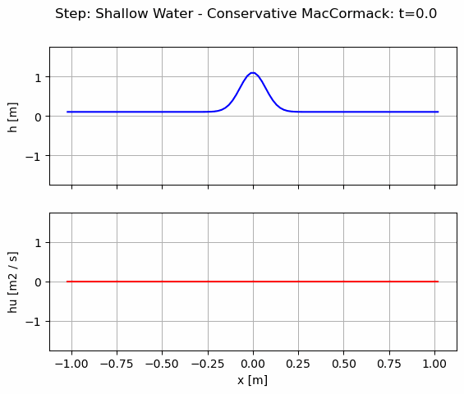
41

Slide 42
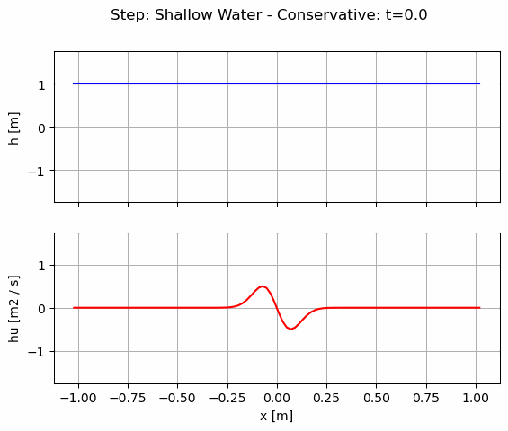
42

Slide 43
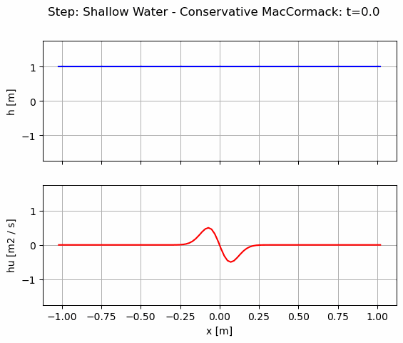
43

Slide 44
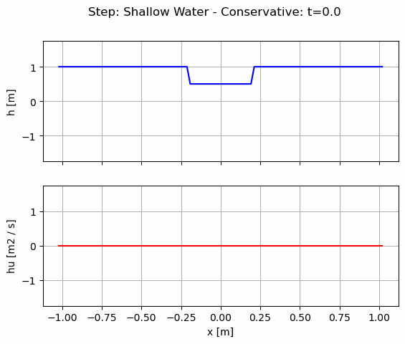
44

Slide 45
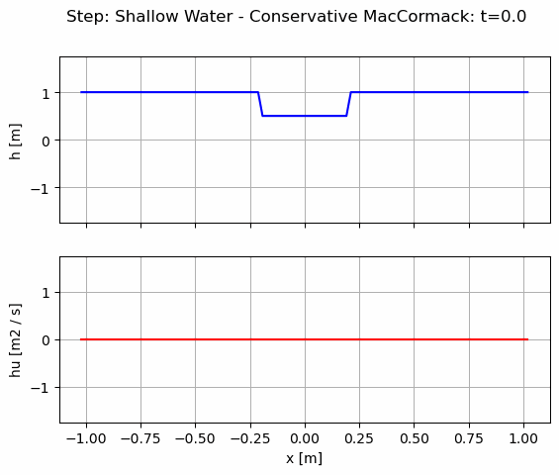
45

Slide 46
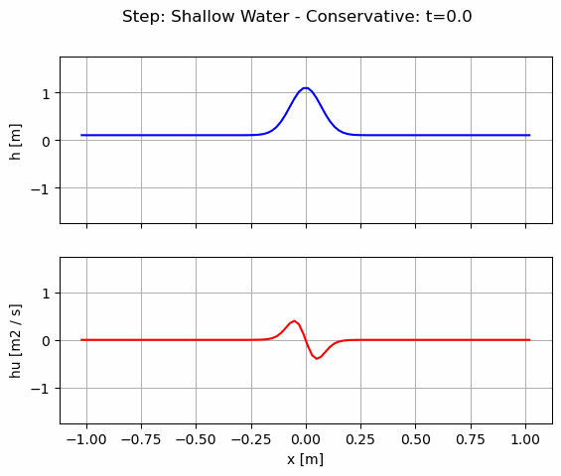
46

Slide 47
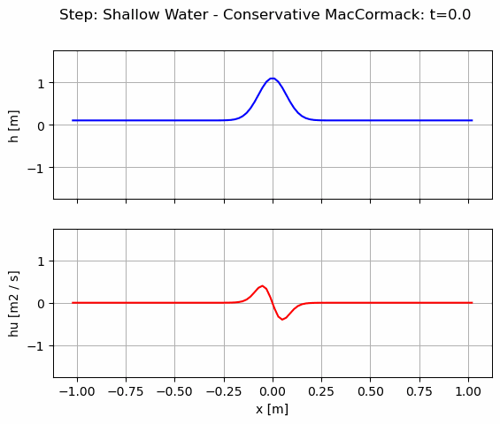
47

Slide 48
Shallow Water Traces
48

Slide 49
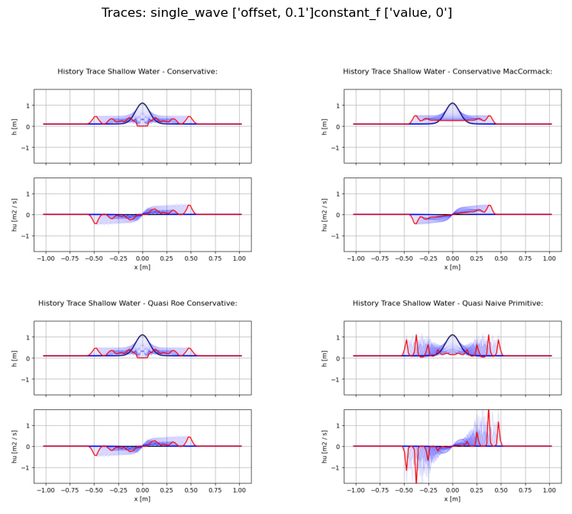
49

Slide 50
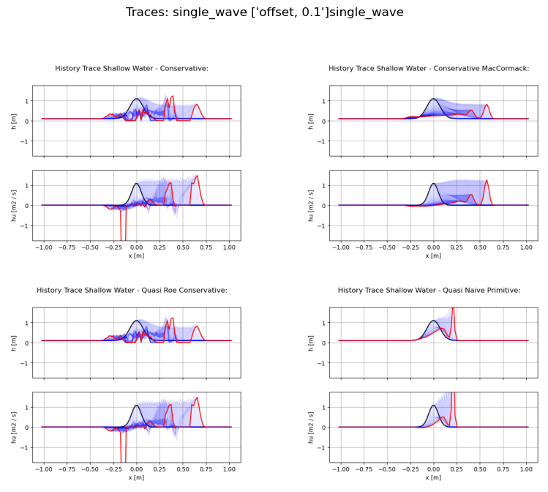
50

Slide 51
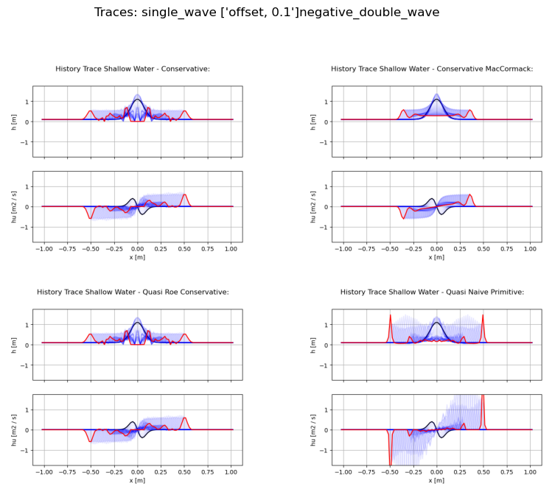
51

Slide 52
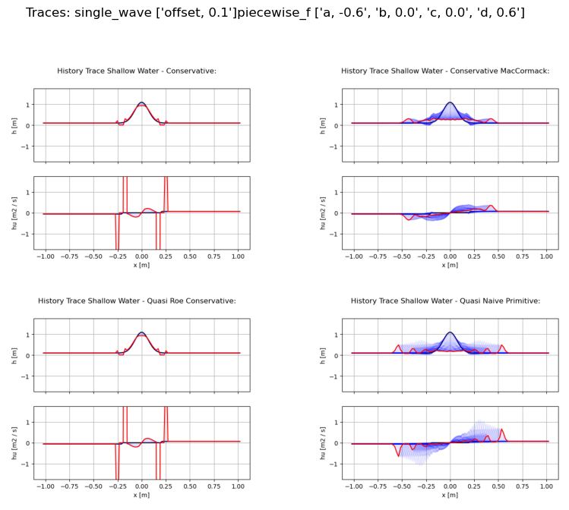
52

Slide 53
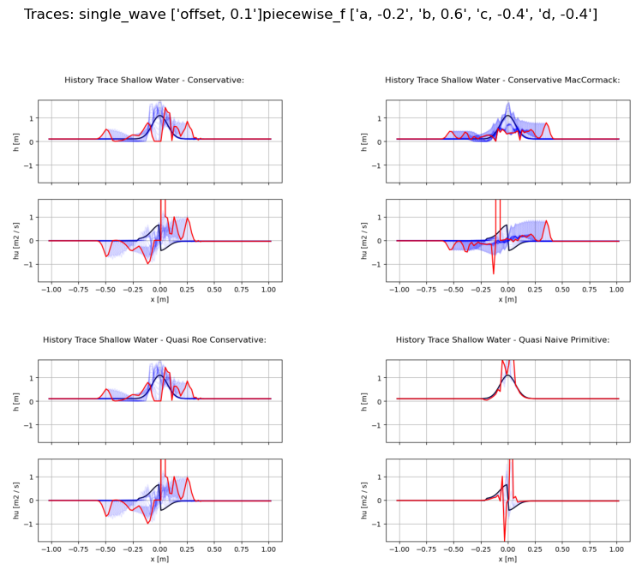
53

Slide 54
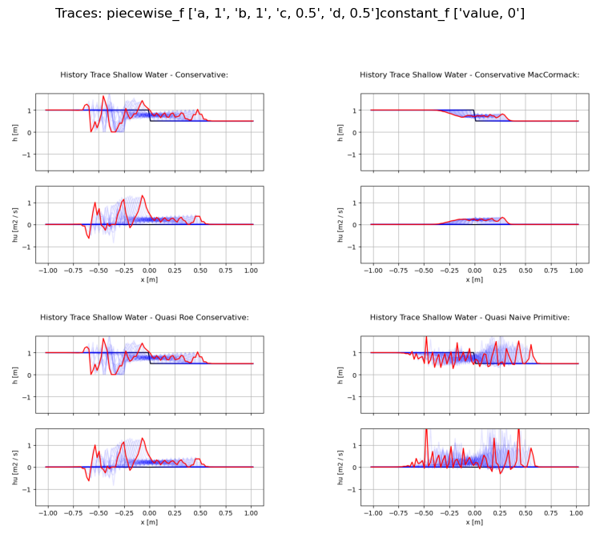
54

Slide 55
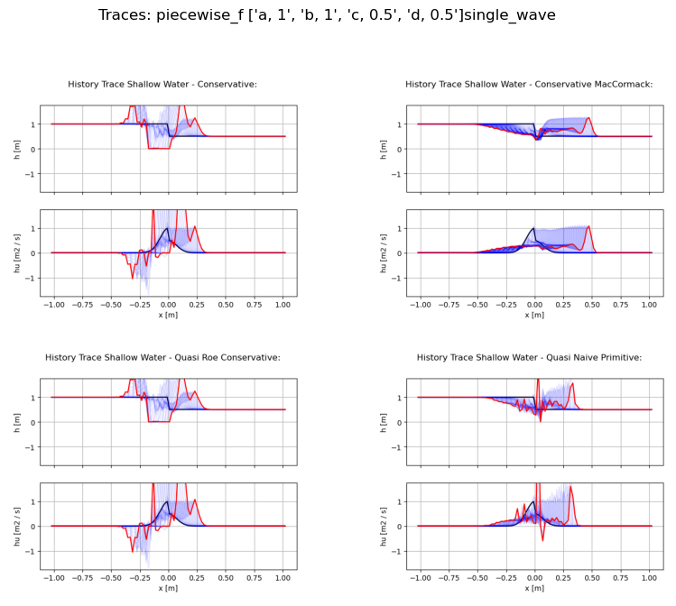
55

Slide 56
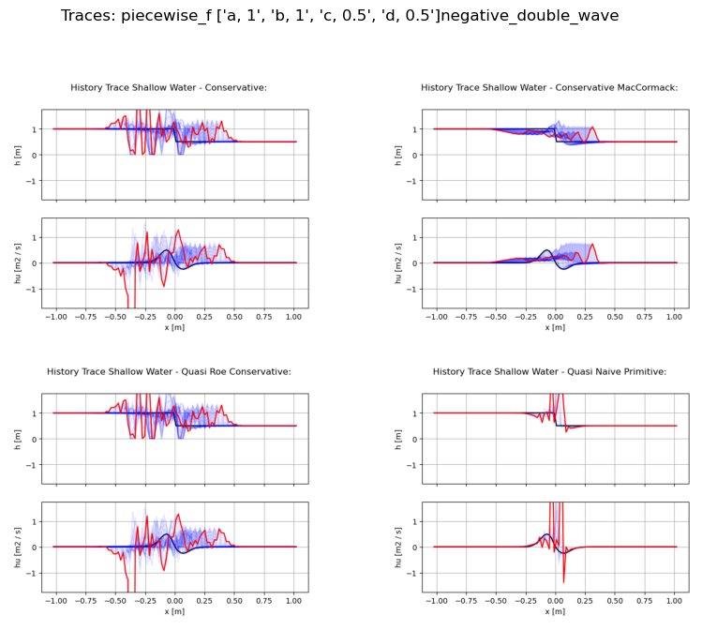
56

Slide 57
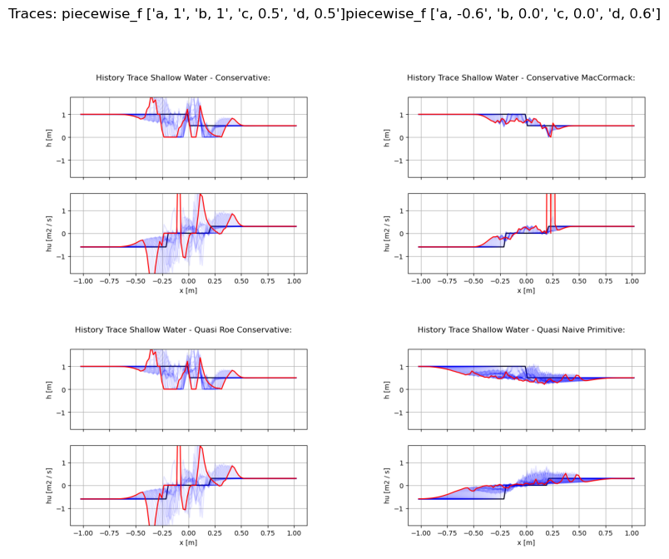
57

Slide 58

58

Slide 59

59

Slide 60

60

Slide 61

61

Slide 62

62

Slide 63

63

Slide 64

64

Slide 65

65

Slide 66

66

Slide 67

67

Slide 68

68

Slide 69

69

Slide 70

70

Slide 71

71

Slide 72

72

Slide 73

73

Slide 74

74

Slide 75

75

Slide 76

76

Slide 77

77

Slide 78

78

Slide 79

79

Slide 80

80

Slide 81

81

Slide 82

82

Slide 83
Numerical Problem Settings
Nx=100;
x in [-1, 1];
CFL ~ 0.05;
Extrapolated BC;
t<1.5 s Burgers
t<0.35 s Shallow Water
83

